Slide 1
NetCDF-CF and standardisation

Slide 2
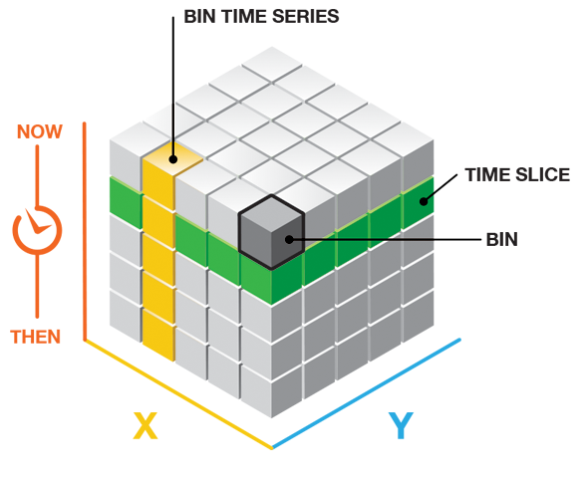
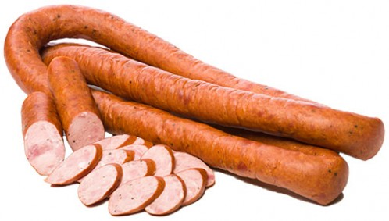
Setup a NetCDF file
Global attributes (metadata)
title
institution
source
references
Conventions (more about this later)
Dimensions (time, lat, lon)
Variables (e.g. discharge [time, lat, lon]
Attributes within variables
_FillValue
units
standard_name
long_name

Slide 3
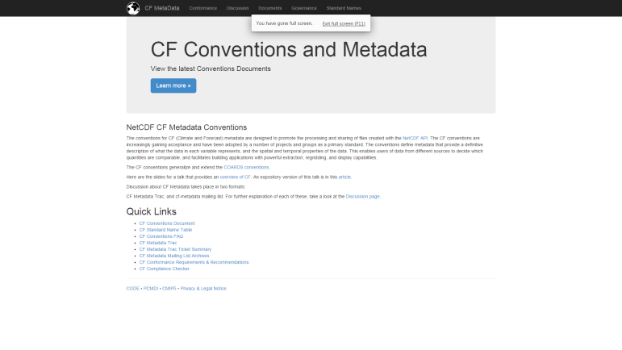
CF-conventions
Climate and Forecast conventions
NetCDF is extremely flexible (nice, but requires agreements)
CF: Set of standards for setting up a NetCDF file
Website: http://cfconventions.org/
Minimum required global attributes
List of “standard_name” attributes for variables, along with agreed units
E.g. standard_name = ‘discharge’; units = ‘m3/s’’
Agreed order in which to write dimensions (e.g. first time, then y, then x)
Axes always in ascending order (so not a descending y-axis like in the GIS community! Flip axis and grids first!)

Slide 4
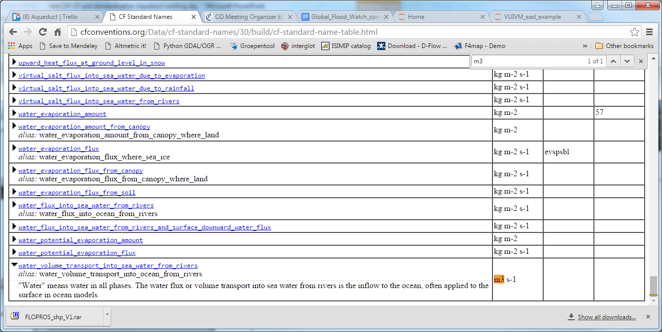
Standard name table
nc_var = nc_trg.createVariable(‘discharge', 'f4', ('time', 'lat', 'lon',), fill_value=fill_value, zlib=True, chunksizes=(1, 90, 180))
nc_var.standard_name = ‘water_volume_transport_into_sea_water_from_rivers’
nc_var.long_name = ‘River discharge’
nc_var.units = ‘m3 s-1’

Slide 5
Setup in python for GFDS data (JRC)
Open a new file
Use the standard format
Use zlib for internal compression (!)
import netCDF4 as nc
nc_trg = nc.Dataset(trg_file, ‘w’, zlib=True)

Slide 6
Setup in python for GFDS data (JRC)
Add dimensions and define their lengths
nc_trg.createDimension('time', 0) # length not known yet, can be extended on the fly
nc_trg.createDimension('lat', len(y)) # length of y axis
nc_trg.createDimension('lon', len(x)) # length of x axis

Slide 7
Setup in python for GFDS data (JRC)
Add variables for the dimensions (inc. attributes!!)
CF-compliant
Data type (float 4-bytes)
name
y_var = nc_trg.createVariable('lat','f4',('lat',))
y_var.standard_name = 'latitude'
y_var.long_name = 'latitude'
y_var.units = 'degrees_north'
y_var.axis = 'Y'
x_var = nc_trg.createVariable('lon','f4',('lon',))
x_var.standard_name = 'longitude'
x_var.long_name = 'longitude'
x_var.units = 'degrees_east'
x_var.axis = 'X'
y_var[:] = y
x_var[:] = x
Tuple of dimension names

Slide 8
Setup in python for GFDS data (JRC)
Add time variable (more complicated)
DateHour = nc_trg.createVariable('time', 'f8',('time',))
DateHour.units = 'Days since 2012-01-01 00:00:00'
DateHour.calendar = ‘gregorian’
DateHour.standard_name = 'time'
DateHour.long_name = 'time'
DateHour[:] = time_list # time_list contains the list of time numbers

Slide 9
Setup in python for GFDS data (JRC)
You can write a projection variable as well
projection= nc_trg.createVariable('projection','c')
projection.long_name = 'wgs84'
projection.EPSG_code = 'EPSG:4326'
projection.proj4_params = '+proj=longlat +ellps=WGS84 +datum=WGS84 +no_defs'
projection.grid_mapping_name = 'latitude_longitude'

Slide 10
Setup in python for GFDS data (JRC)
Global attributes (just a few mandatory ones)
metadata = {}
metadata['title'] = 'GDACS - Flood Detection Data'
metadata['institution'] = 'Global Disaster Alert and Coordination System (GDACS) - NetCDF Conversion by Deltares'
metadata['source'] = 'Joint Research Centre'
metadata['references'] = 'http://www.gdacs.org/flooddetection/download.aspx, http://onlinelibrary.wiley.com/doi/10.1029/2006WR005238/abstract'
metadata['Conventions'] = 'CF-1.4'
metadata['history'] = time.ctime()
for attr in metadata:
nc_trg.setncattr(attr, metadata[attr])
nc_trg.sync() # sync data in file
nc_trg.close() # close the file (don’t forget this)

Slide 11
Setup in python for GFDS data (JRC)
What do we have now?
A file
Global attributes
Dimensions clear
But there is no real variables in the file yet
And no data in variables

Slide 12
Setup in python for GFDS data (JRC)
Add a variable (very similar to the lat, lon, time axes)
# prepare the variable
nc_var = nc_trg.createVariable(trgVar, 'f4', ('time', 'lat', 'lon',), fill_value=-9999., zlib=True, chunksizes=(1, 180, 360))
nc_var.units = trgUnits
nc_var.standard_name = trgName
fill_value=-9999 adds a metadata attribute _FillValue to the variable. Used to mask areas in your data
zlib=True ensures that the variable is internally compressed for efficient storage
chunksizes=(1, 180, 360) controls in what chunks data is saved (and compressed). In case of large files, very important to control this, dependent on how you want to slice data from the file

Slide 14
How to kickstart?
NetCDF Kickstarter:
http://zandmotor.citg.tudelft.nl/netcdfkickstarter/
Makes a template script in MATLAB/Python (other languages not yet) for setting up CF compliant files
Global attributes (inc. projection)
Dimensions
Variables

